Slide 1





Content includes material subject to © Crown copyright (2018), Dstl and © Crown copyright (2018), PHE. This material is licensed under the terms of the Open Government Licence except where otherwise stated. To view this licence, visit http://www.nationalarchives.gov.uk/doc/open-government-licence/version/3 or write to the Information Policy Team, The National Archives, Kew, London TW9 4DU, or email: psi@nationalarchives.gsi.gov.uk
Content includes material © Riskaware 2018
Uncertainty Visualization Study Group

Slide 2
Uncertainty Visualization Study Group Theme 3: Spatio-temporal visualization of hazard areas and populations at risk Dr Thomas Finnie Senior Geospatial Modeller Public Health England
Notes:
giving the capability to make informed decisions based on the available ensemble of epidemic models.
together with a documented evidence thread for incorporation into the BSVE

Slide 3
Introduction
Modelling method including spatial and temporal components, e.g. Legionella
Chain of models:
Plume model provides information about where disease particles spread and require meteorological data, geographical features etc.
Disease model describes how disease particles affect individuals
Spatio-temporal model:
Includes spatial and time elements.
Plume mode:
Describes the spread of disease particles over a geographical area.
Disease model:
Describes how disease particles interact with individuals. Used to predict number of people falling ill.

Slide 4
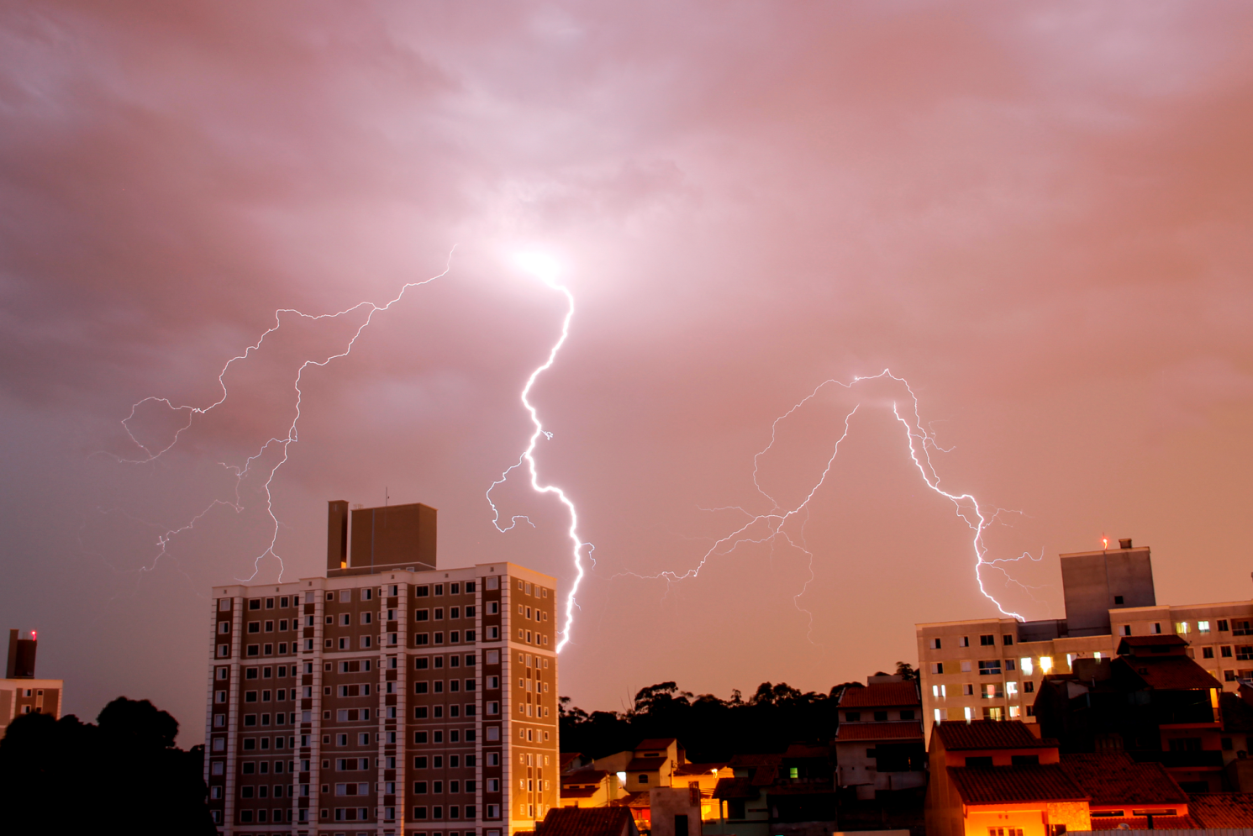
Introduction
Spatio-temporal model:
Includes spatial and time elements.
Plume mode:
Describes the spread of disease particles over a geographical area.
Disease model:
Describes how disease particles interact with individuals. Used to predict number of people falling ill.
Photograph Eric Gaieta underCC0 license

Slide 5
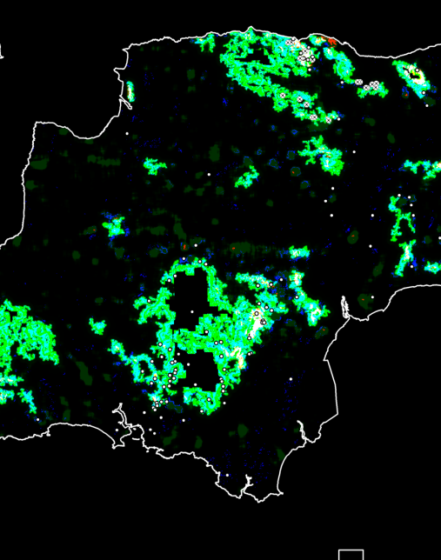
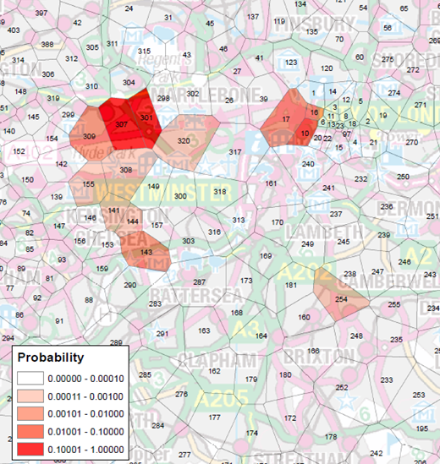
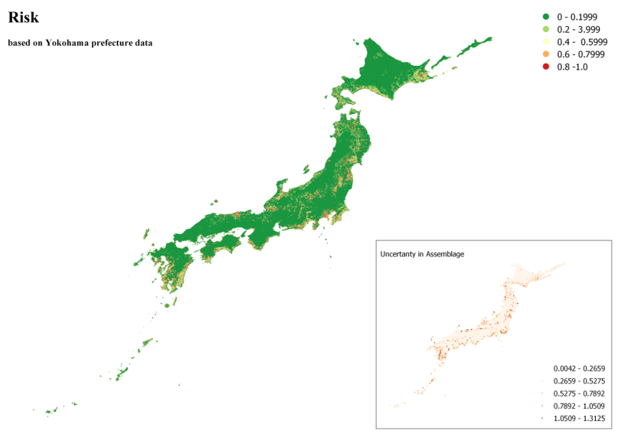
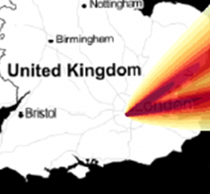
Existing methods for visualizing model outputs
Spatio-temporal model:
Includes spatial and time elements.
Plume mode:
Describes the spread of disease particles over a geographical area.
Disease model:
Describes how disease particles interact with individuals. Used to predict number of people falling ill.

Slide 6
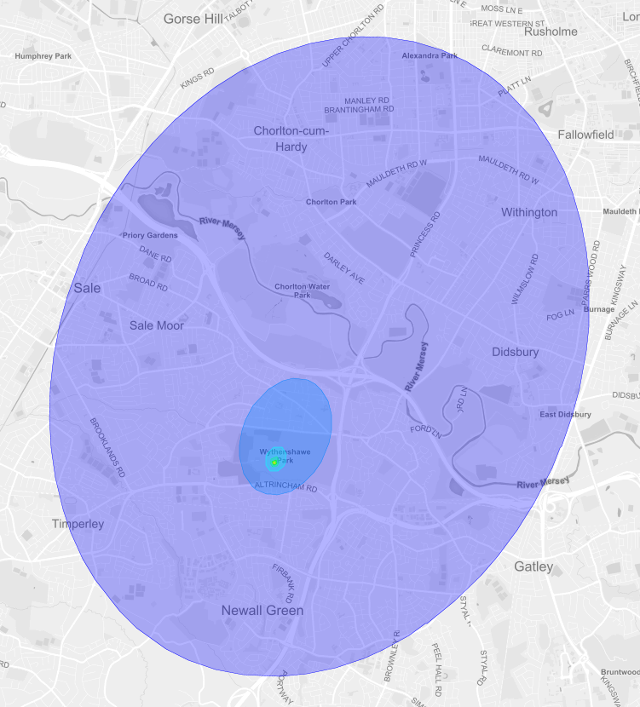
Data

Slide 7
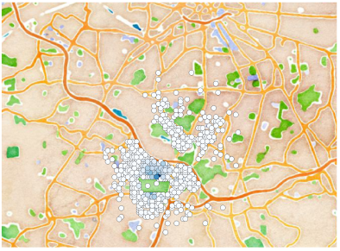
Data

Slide 8
Data
250 plumes with 4 realisations per plume
For each plume:
One file containing plume contour
One file containing point data
Disease particles
Population
Number of infected people
Notes:
giving the capability to make informed decisions based on the available ensemble of epidemic models.
together with a documented evidence thread for incorporation into the BSVE

Slide 9
Expectations
Innovative methods for visualizing the variety of outputs
Computer code
Illustrations
Concepts

